Slide 1
Loan Approval Risk Simulation for an Aging Population
M-INTRO
2025
Explores how loan approval outcomes and financial risk evolve as populations age
MIHRET TESFAYE (LEAD)
JOSHUA DAVIS

Slide 2
PROBLEM & QUESTION
M-PROBLEM
PROBLEM
How will loan approval outcomes and financial risk evolve as populations age?
Focusing on individuals aged 50 to 70
Can you compare the simulation against actual data???

Slide 3
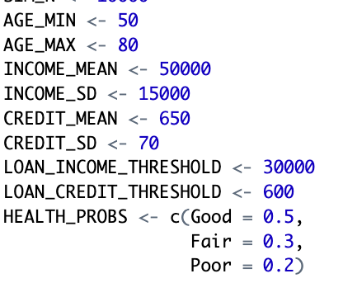
LOAN APPROVAL MODEL
M-PROBLEM
MODEL
AGE MIN

Slide 4
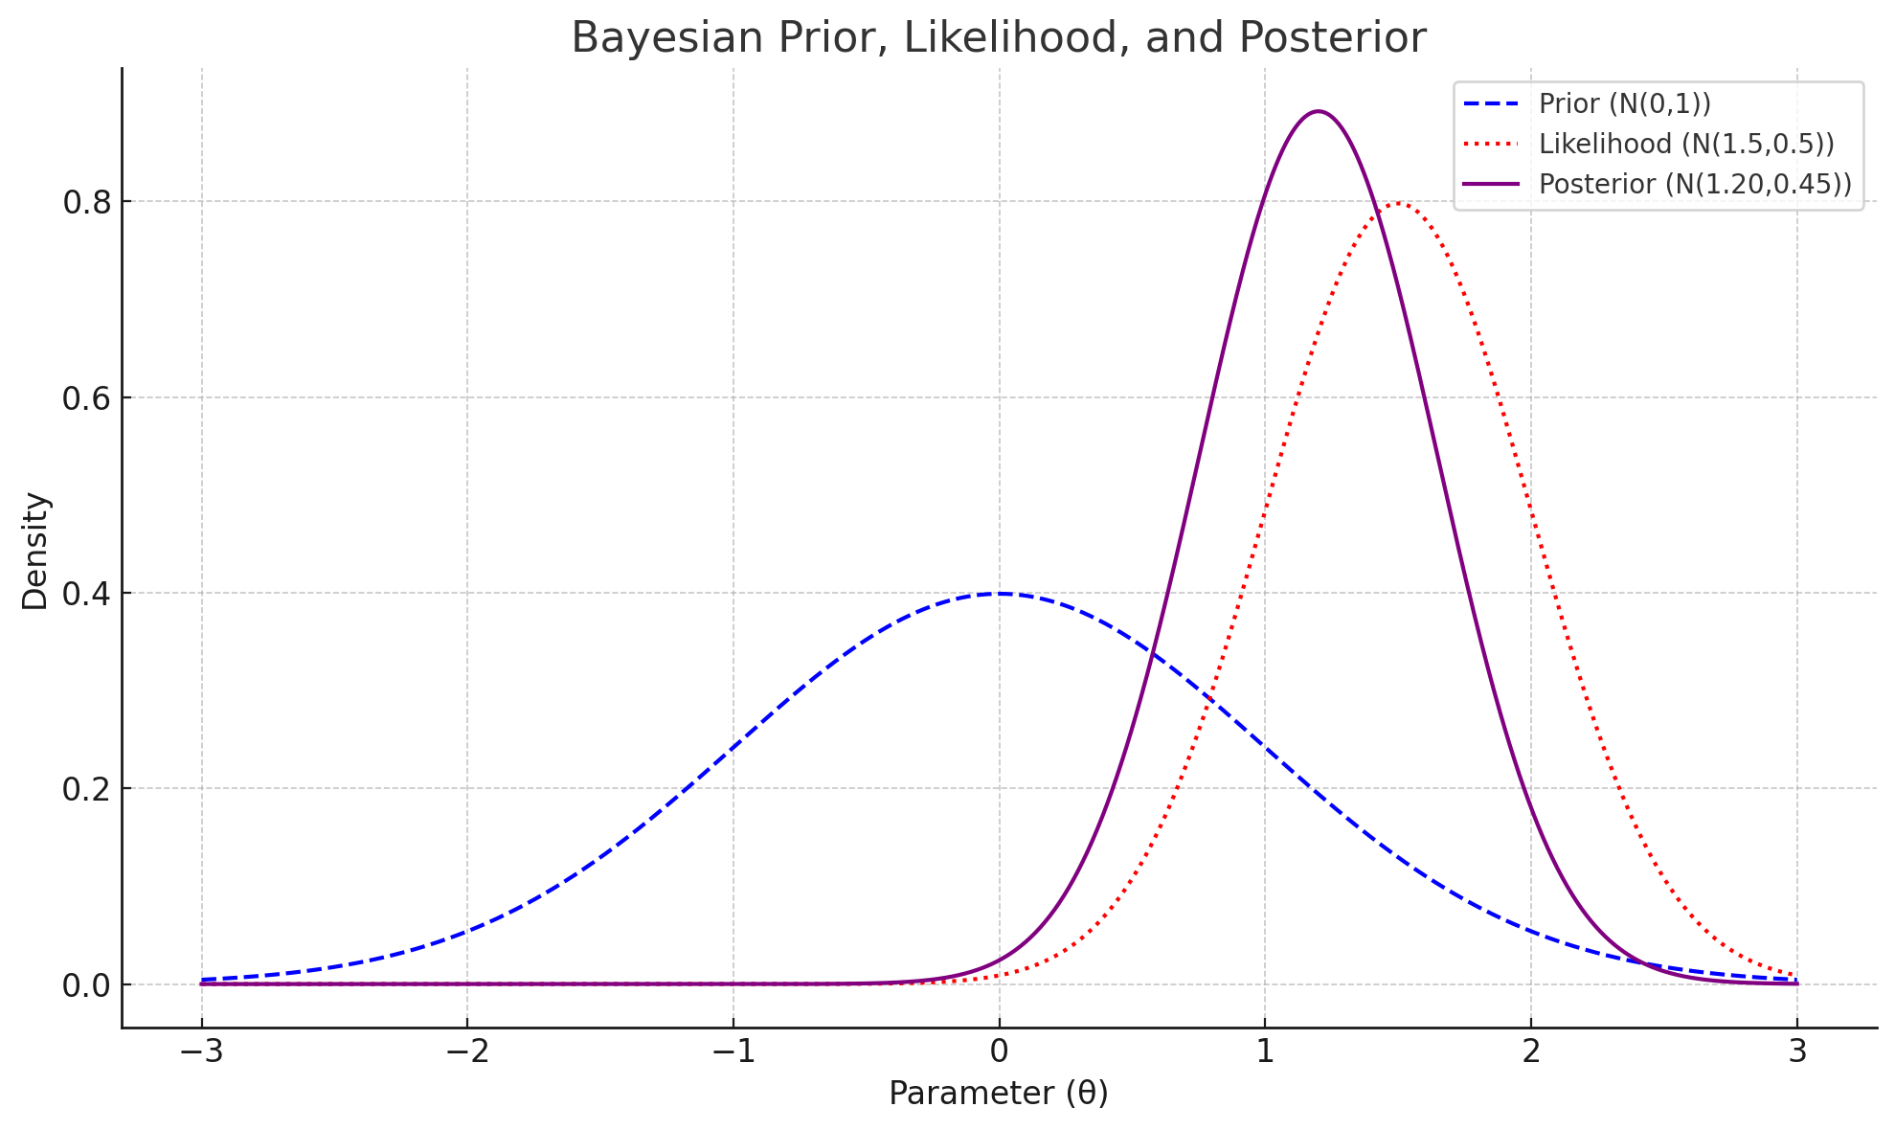
STATISTICAL FRAMEWORK
RESEARCH
M-PROBLEM
MODEL
Target Population: Ages 50–70 (Uniform distribution)
Key Variables: Age, Income (Normal), Credit Score (Normal), Health Status (Categorical)
Loan Approval: Bayesian logistic regression model
Simulation Method: Monte Carlo simulation with 10,000 synthetic individuals and repeated runs for variability
Outputs: Approval probabilities and financial risk trends by age

Slide 5
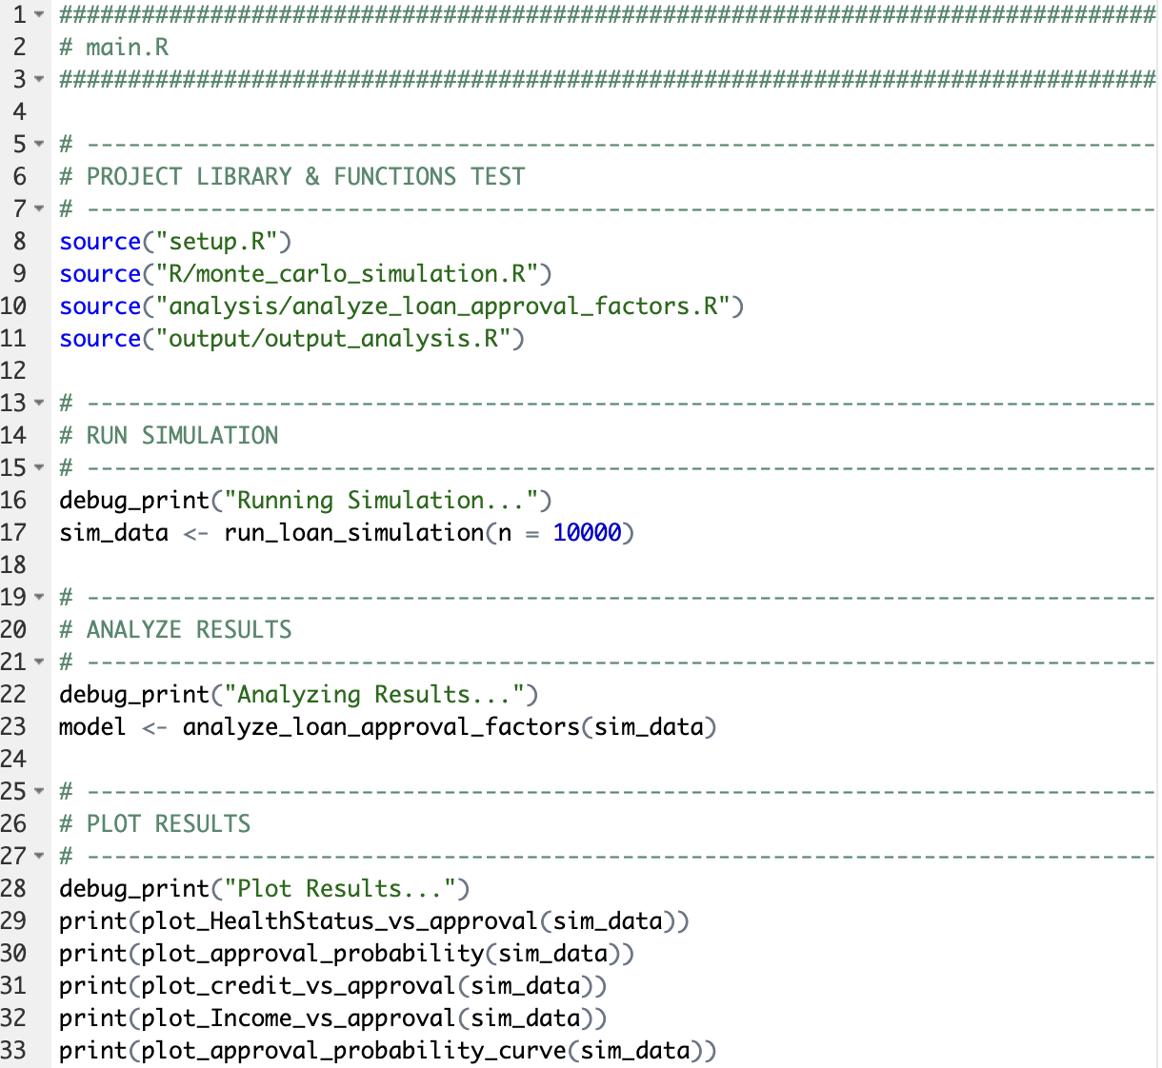
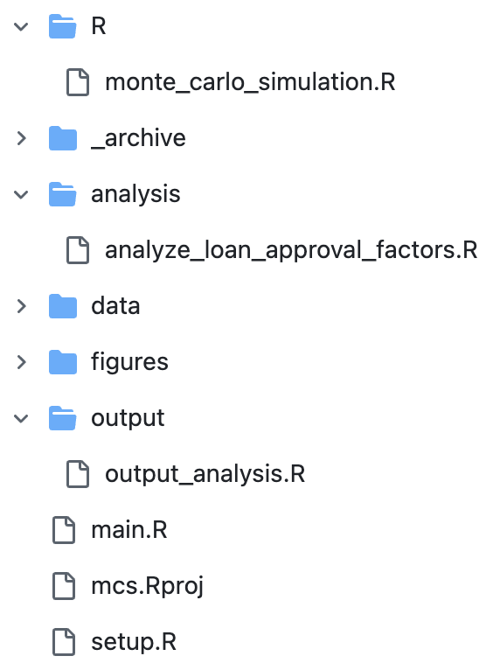
IMPLIMENTATION
JOSH – EXPLAIN..
CODE

Slide 6
IMPLIMENTATION
CODE
??
JOSH - FLOW

Slide 7
MONTE CARLO SIMULATION
SIM
JOSH – EXPLAIN..
PURPOSE | DESCRIPTION
Quantify risk | Explore approval variability under different conditions
Test policies | Evaluate rule changes before implementing them
Analyze fairness | Detect disparities by subgroup (age, health, etc.)
Support compliance | Useful for ethics reviews or audits
Forecast outcomes | Predict approval rates, default, or profitability

Slide 8
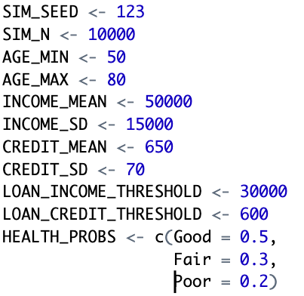
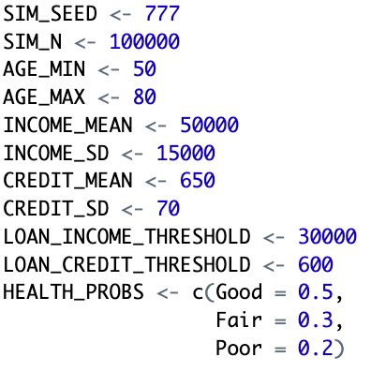
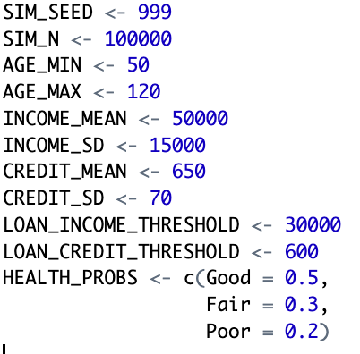
EXPERIMENTATIONS
JOSH – EXPLAIN..
SIM
??

Slide 9
ANALYSIS
M – EXPLAIN..
INSIGHT
???

Slide 10
ARTIFICAL INTELLIGENCE (AI) USE
JOSH – EXPLAIN..
INSIGHT
PURPOSE | DESCRIPTION
Debug Errors | Quickly explore why an error is caused and how to resolve
Brainstorming | Tool to facilitate exploration in thought and approaches within the scope of statistics and R
Query for Methods | Discover methods quickly that will facilitate goal / application
R Reference Guide | Use like a book when exploring the R language and its associated libraries
Best Practices | Explore how the R community generally develops (e.g. folder structures, naming conventions, etc.)
Refactoring | Leverage to discover approaches for simplifying source for clarity and readability

Slide 11
CONCLUSIONS
INSIGHT
??

Slide 12
Loan Approval Risk Simulation for an Aging Population
2025
Explores how loan approval outcomes and financial risk evolve as populations age
MIHRET TESFAYE (LEAD)
JOSHUA DAVIS

